Slide 1
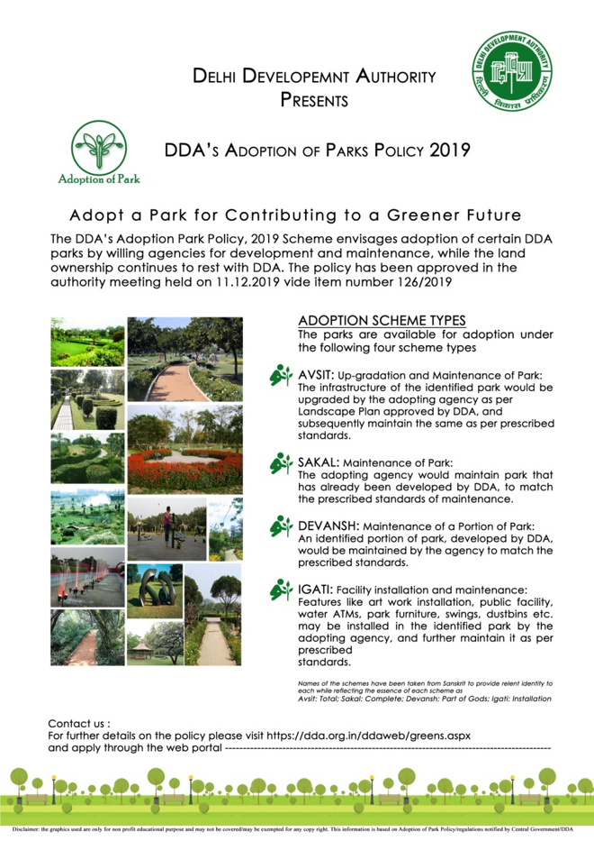
DDA Adoption of Parks Policy 2019.
DDA Adoption of Parks Policy 2019 (Application Format)
“Click to Apply for Adoption of Park”
Link to the Online Portal*

